Slide 1
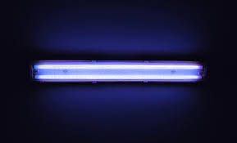
AMITY UNIVERSITY Rajasthan
APPLIED CHEMISTRY PRESENTATION
PRESENTED BY-:
Mohammad Yusuf Khan
Arpit Agarwal……………
Diptansh Kumar…………
Divyank Kumar……….....
Tushar Harinkhere……....

Slide 2
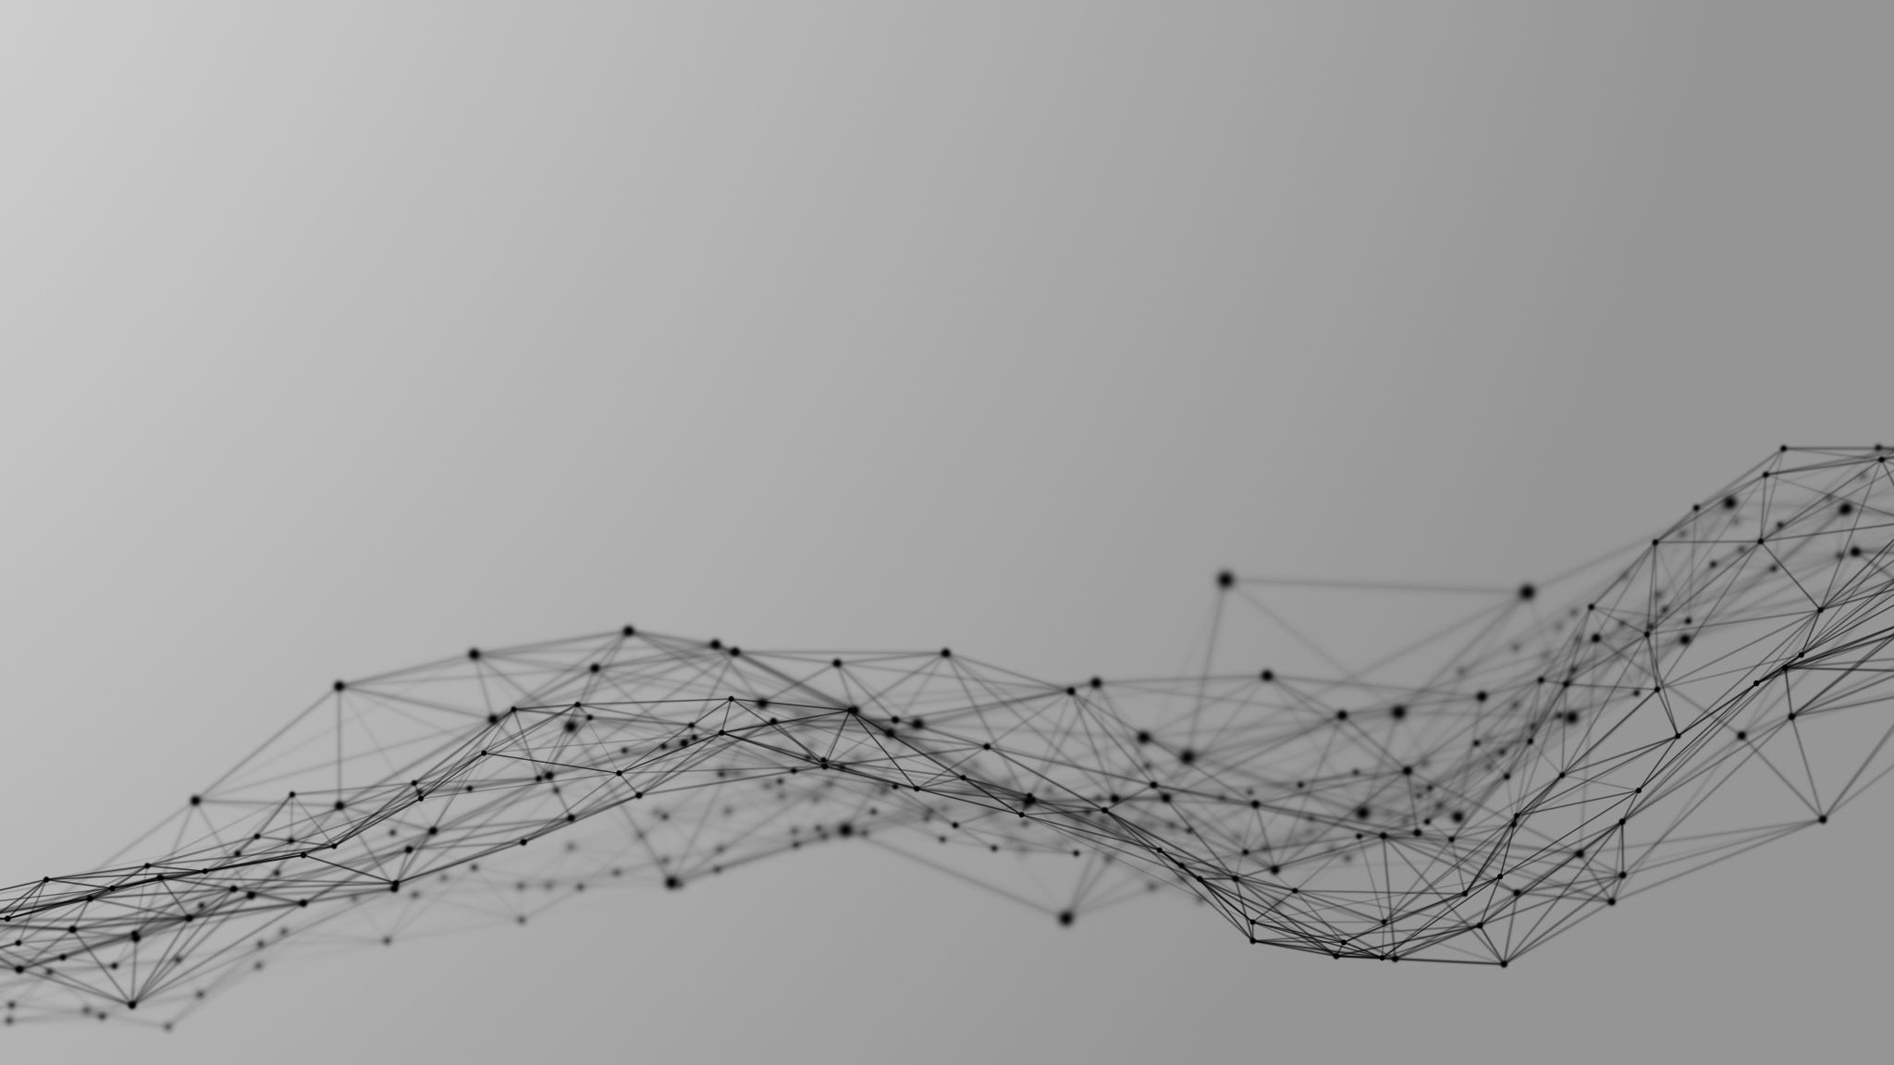
UV: Principle, Instrumentation, Application
Instrumental Method of Analysis

Slide 3
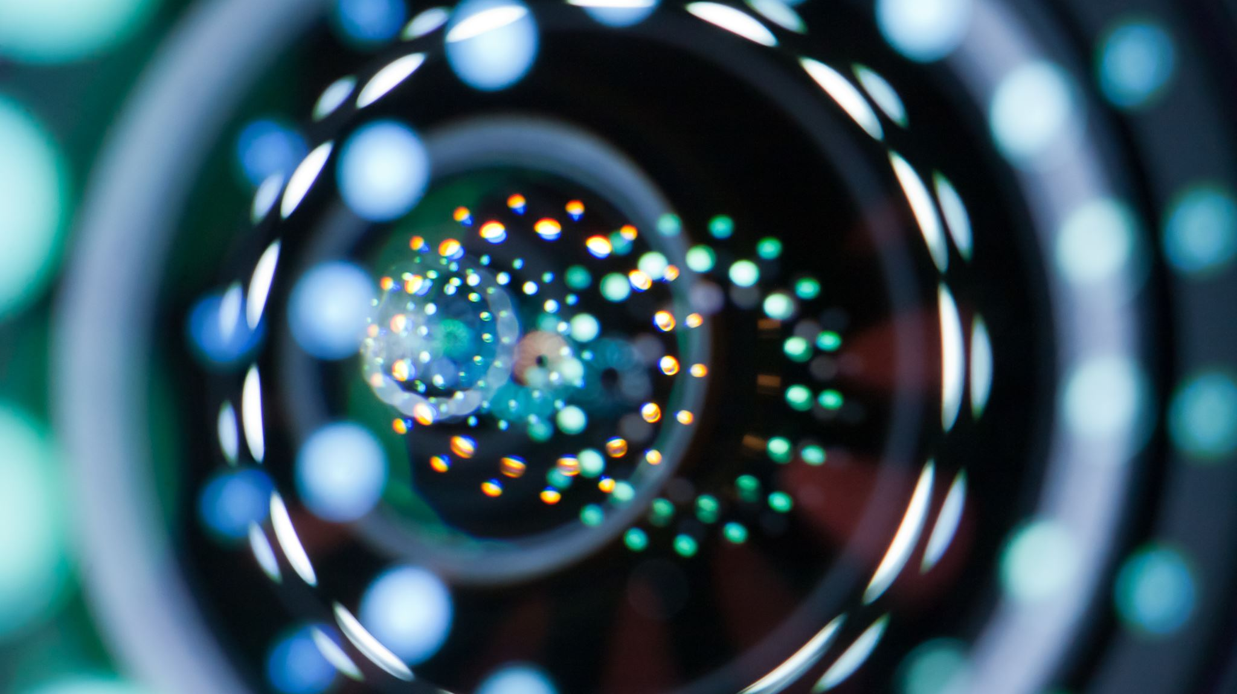
Introduction
What is UV?
Ultraviolet radiation, that portion of the electromagnetic spectrum extending from the violet, or short-wavelength, end of the visible light range to the X-ray region. Ultraviolet (UV) radiation is undetectable by the human eye, although, when it falls on certain materials, it may cause them to fluoresce—i.e., emit electromagnetic radiation of lower energy, such as visible light. Many insects, however, are able to see ultraviolet radiation.

Slide 4

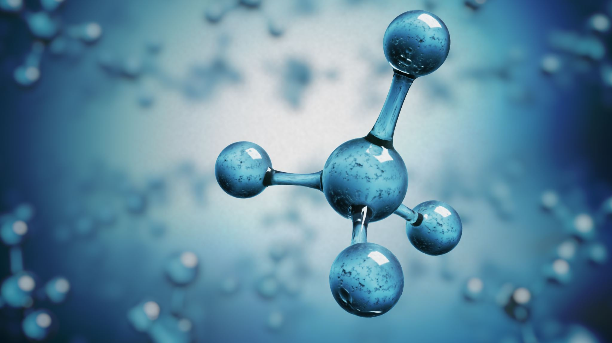

UV Spectroscopy
Spectroscopy is the measurement and interpretation of electromagnetic radiation absorbed or emitted when the molecules or atoms or ions of a sample moves from one energy state to another energy state.
UV spectroscopy is type of absorption spectroscopy in which light of ultra-violet region (200-400 nm) is absorbed by the molecule which results in the excitation of the electrons from the ground state to higher energy state.

Slide 5

Principle of UV Spectroscopy
Basically, spectroscopy is related to the interaction of light with matter.
As light is absorbed by matter, the result is an increase in the energy content of the atoms or molecules.
When ultraviolet radiations are absorbed, this results in the excitation of the electrons from the ground state towards a higher energy state.
Molecules containing π-electrons or non-bonding electrons (n-electrons) can absorb energy in the form of ultraviolet light to excite these electrons to higher anti-bonding molecular orbitals.

Slide 6
Principle of UV Spectroscopy
The more easily excited the electrons, the longer the wavelength of light it can absorb. There are four possible types of transitions (π–π*, n–π*, σ–σ*, and n–σ*), and they can be ordered as follows: σ–σ* > n–σ* > π–π* > n–π*
The absorption of ultraviolet light by a chemical compound will produce a distinct spectrum which aids in the identification of the compound.

Slide 7
Instrumentation of UV Spectroscopy

Slide 8
Light Source
Tungsten filament lamps and Hydrogen-Deuterium lamps are most widely used and suitable light source as they cover the whole UV region.
Tungsten filament lamps are rich in red radiations; more specifically they emit the radiations of 375 nm, while the intensity of Hydrogen-Deuterium lamps falls below 375 nm.

Slide 9
Monochromator
Monochromators generally is composed of prisms and slits.
Most of the spectrophotometers are double beam spectrophotometers.
The radiation emitted from the primary source is dispersed with the help of rotating prisms.
The various wavelengths of the light source which are separated by the prism are then selected by the slits such the rotation of the prism results in a series of continuously increasing wavelength to pass through the slits for recording purpose.
The beam selected by the slit is monochromatic and further divided into two beams with the help of another prism.

Slide 10
Sample and reference cells
One of the two divided beams is passed through the sample solution and second beam is passé through the reference solution.
Both sample and reference solution are contained in the cells.
These cells are made of either silica or quartz. Glass can’t be used for the cells as it also absorbs light in the UV region.

Slide 11
Detector
Generally two photocells serve the purpose of detector in UV spectroscopy.
One of the photocell receives the beam from sample cell and second detector receives the beam from the reference.
The intensity of the radiation from the reference cell is stronger than the beam of sample cell. This results in the generation of pulsating or alternating currents in the photocells

Slide 12
Amplifier
The alternating current generated in the photocells is transferred to the amplifier.
The amplifier is coupled to a small servometer.
Generally current generated in the photocells is of very low intensity, the main purpose of amplifier is to amplify the signals many times so we can get clear and recordable signals.

Slide 13
Recording devices
Most of the time amplifier is coupled to a pen recorder which is connected to the computer.
Computer stores all the data generated and produces the spectrum of the desired compound.

Slide 14
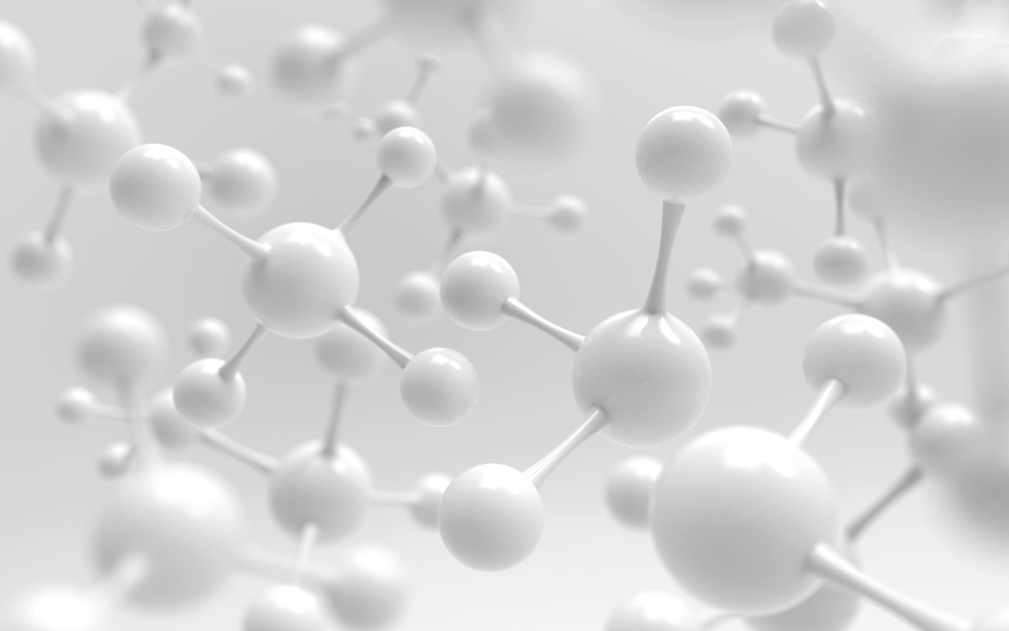
Applications of UV Spectroscopy

Slide 15
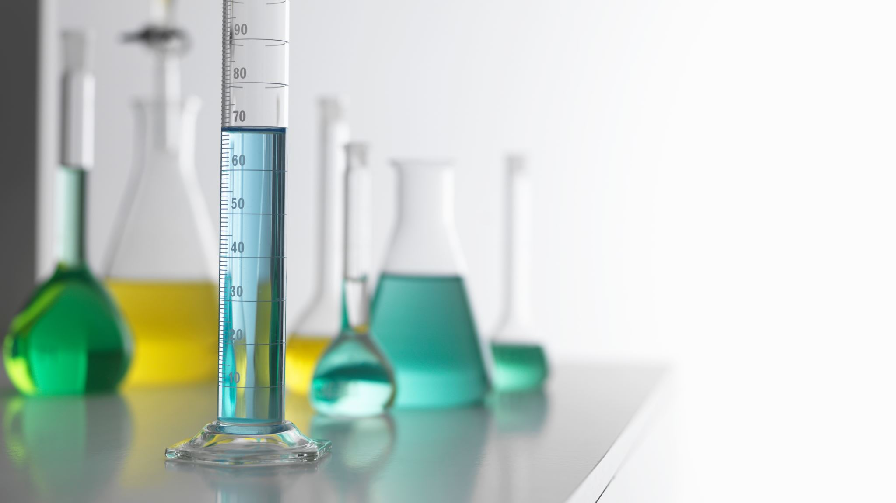
Detection of Impurities
It is one of the best methods for determination of impurities in organic molecules.
Additional peaks can be observed due to impurities in the sample and it can be compared with that of standard raw material.
By also measuring the absorbance at specific wavelength, the impurities can be detected.

Slide 16
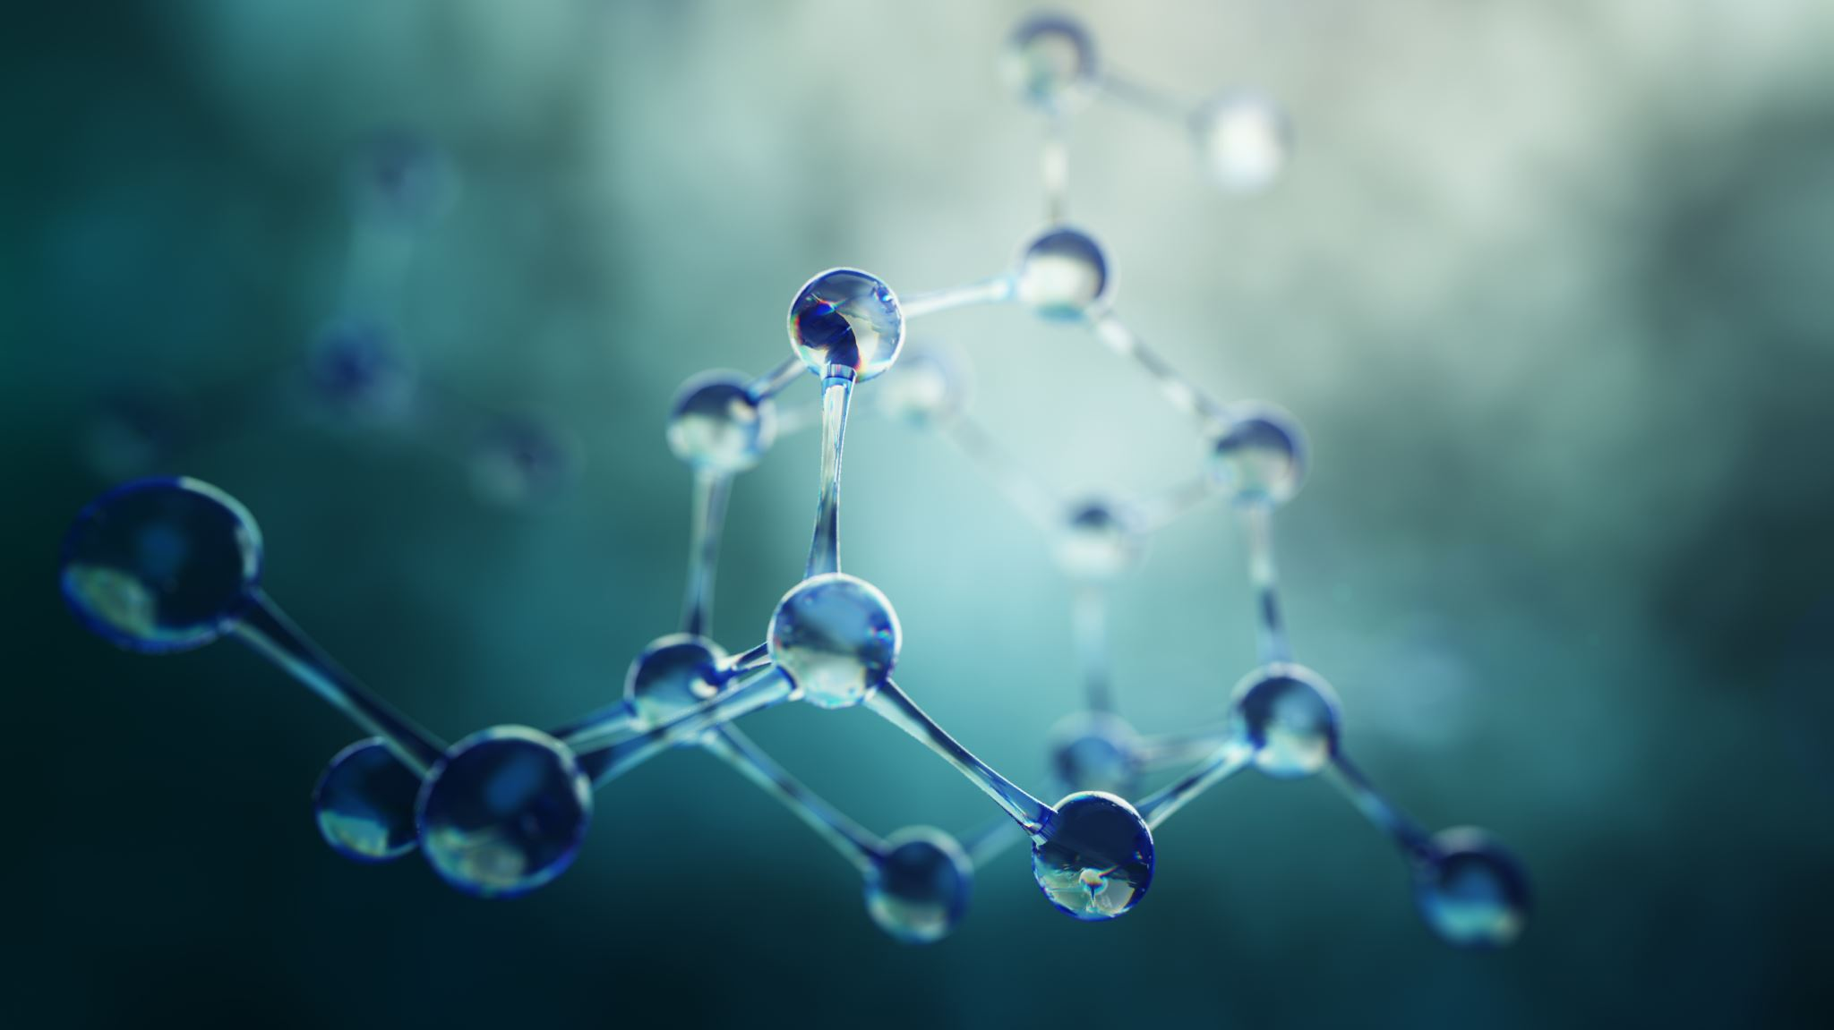
Structure elucidation of organic compounds
It is useful in the structure elucidation of organic molecules, such as in detecting the presence or absence of unsaturation, the presence of hetero atoms.

Slide 17

UV absorption spectroscopy can be used for the quantitative determination of compounds that absorb UV radiation.
UV absorption spectroscopy can characterize those types of compounds which absorbs UV radiation thus used in qualitative determination of compounds. Identification is done by comparing the absorption spectrum with the spectra of known compounds.
This technique is used to detect the presence or absence of functional group in the compound. Absence of a band at particular wavelength regarded as an evidence for absence of particular group.

Slide 18

Other Applications of UV Spectroscopy
Kinetics of reaction can also be studied using UV spectroscopy. The UV radiation is passed through the reaction cell and the absorbance changes can be observed.
Many drugs are either in the form of raw material or in the form of formulation. They can be assayed by making a suitable solution of the drug in a solvent and measuring the absorbance at specific wavelength.
Molecular weights of compounds can be measured spectrophotometrically by preparing the suitable derivatives of these compounds.
UV spectrophotometer may be used as a detector for HPLC.

Slide 19

For giving us this opportunity and providing us a platform where we presented our work. We learned many new things during the project and gained experience and knowledge.

